Slide 1
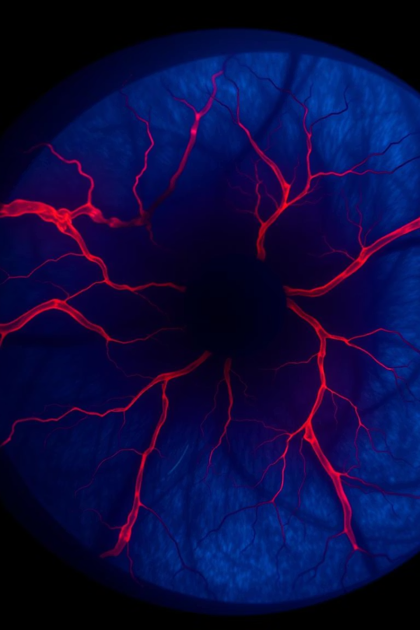
Diabetic Retinopathy Detection Using Deep Learning
A Retinal Image Classification Approach
Presented By : Darshan Shetty R
2nd MCA
P05AZ23S126006
Guided By : Dr. B.H Shekar
Professor in Computer Science

Slide 2
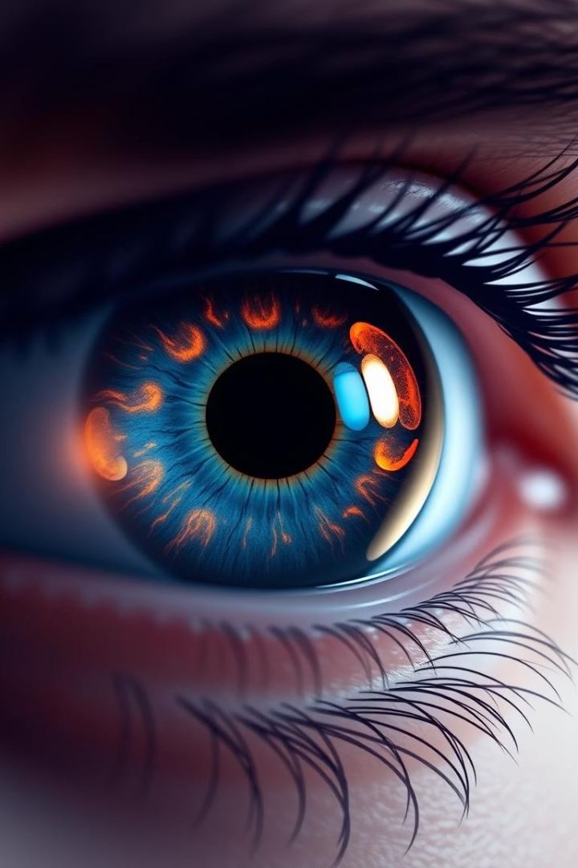
Introduction to Diabetic Retinopathy
What is Diabetic Retinopathy?
Importance of Early Detection
A serious eye complication caused by diabetes that can lead to blindness if untreated.
Early diagnosis is critical to prevent vision loss and enable timely treatment.
Role of AI and Deep Learning
Automated models offer fast, accurate, and scalable screening solutions in medical imaging.

Slide 3
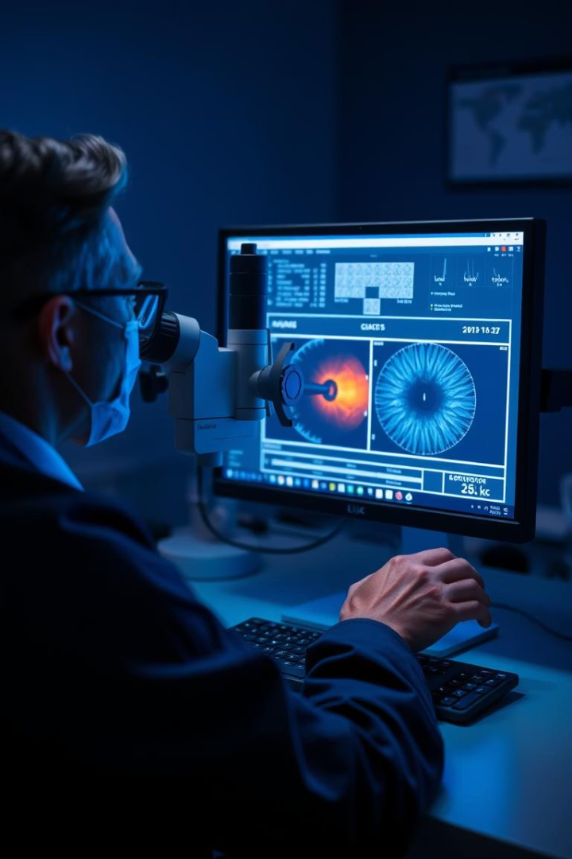
Problem Statement
Manual Diagnosis Challenges
Time-consuming process requiring expert ophthalmologists, limiting screening capacity.
Need for Automation
Scalable and efficient solutions are essential to meet growing screening demands.

Slide 4
Project Goals and Objectives
Deep Learning Model
Clinical Utility
Develop a CNN-based model to classify diabetic retinopathy severity from fundus images.
Improve accuracy and speed to support real-world screening and diagnosis processes.

Slide 5
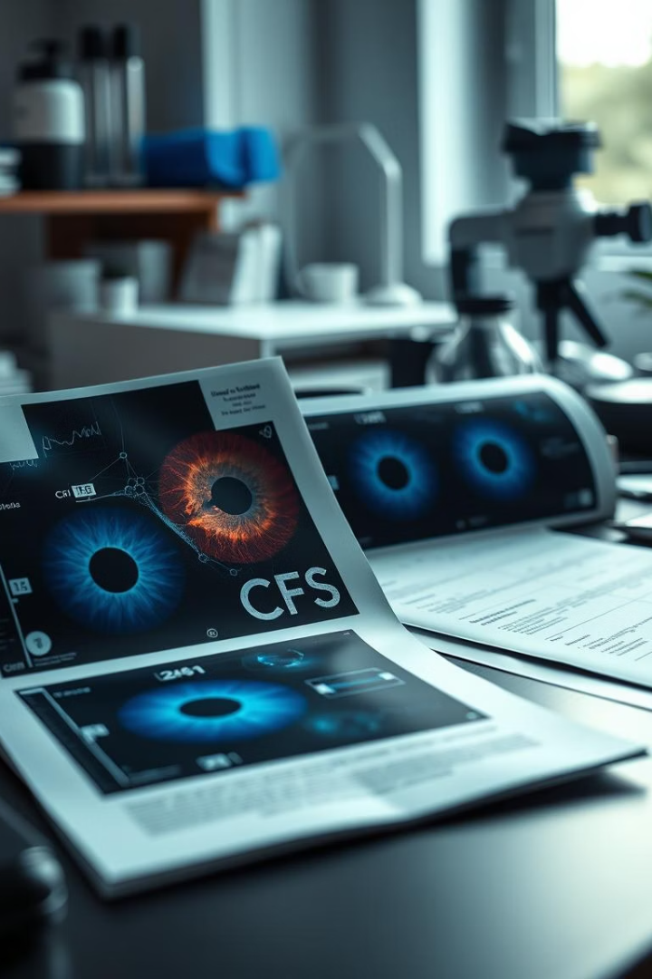
Literature Review
Prior Work
Key Study
Models like VGG16, ResNet50, and InceptionV3 have been applied to DR detection.
Kermany et al. (2018) demonstrated promising results using deep learning for retinal diseases.
Research Gaps
Challenges remain with rare class accuracy and reducing false positives in classification.

Slide 6
Dataset Overview
Data Source
DR Severity Classes
Challenges
Kaggle datasets including APTOS and EyePACS with thousands of labeled retinal images.
Five classes ranging from 0 (No DR) to 4 (Proliferative DR) to represent disease progression.
Significant class imbalance affects model training and performance.

Slide 7
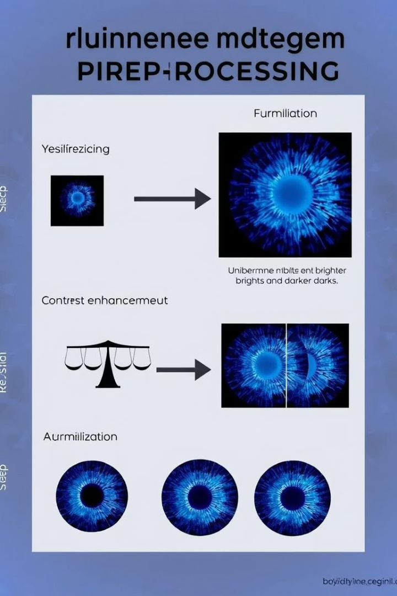
Image Preprocessing
Resizing and Normalization
Contrast Enhancement
Standardize image dimensions and pixel intensity for consistent input to the model.
Improve visibility of retinal features critical for accurate classification.
Data Augmentation
Techniques like rotation, flipping, zoom, and brightness adjustments to increase data diversity.

Slide 8
Model Architecture
CNN Backbone
Output Layer
Utilizes ResNet50 architecture with convolutional, activation, pooling, and dropout layers.
Softmax activation for multi-class classification across five DR severity levels.

Slide 9

Training and Evaluation
Training Setup
Evaluation Metrics
Challenges
Implemented in Python using TensorFlow and Keras with Adam optimizer and categorical crossentropy loss.
Model performance assessed using accuracy, F1-score, confusion matrix, and AUC-ROC curves.
Addressed class imbalance, GPU constraints, and overfitting during training.

Slide 10
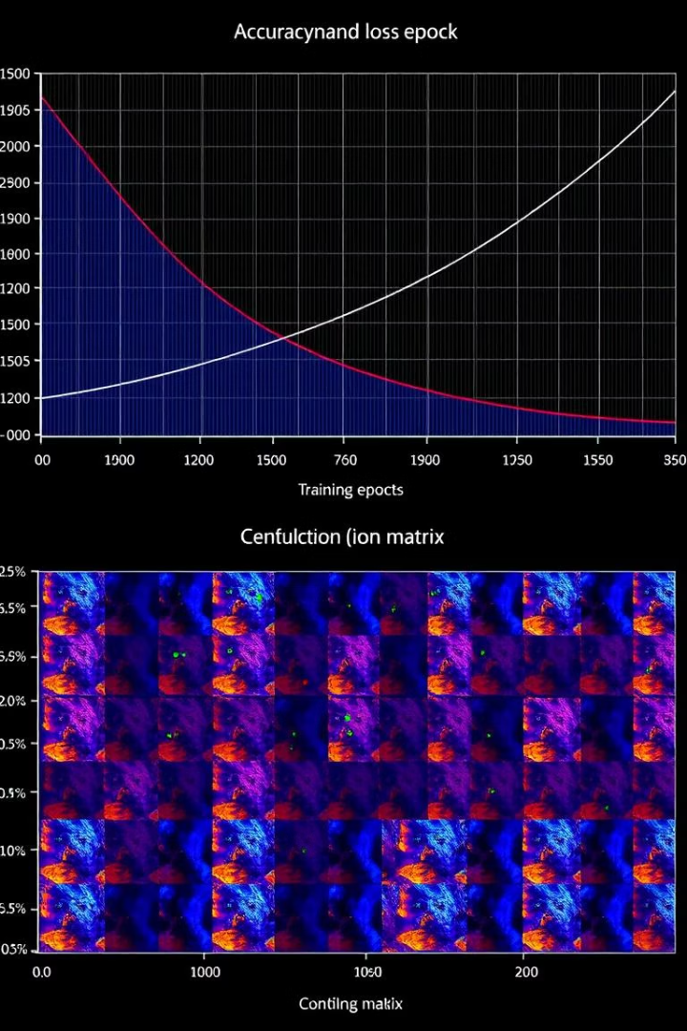
Results Visualization & Model Insights
Accuracy and loss curves reveal training progress
Confusion matrix shows classification strengths and weaknesses
Sample predictions highlight correct and misclassified cases
Training trends expose overfitting risks and regularization impact

Slide 11
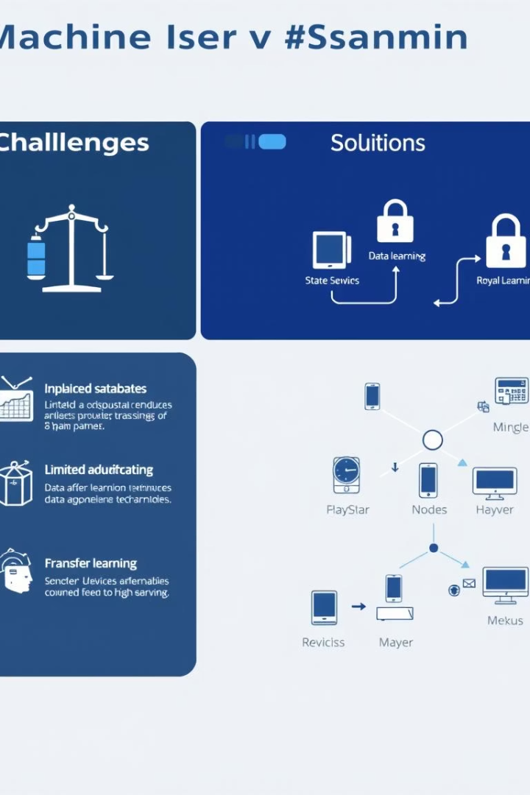
Challenges, Solutions & References
Challenges
Solutions
Imbalanced data and poor image quality
Data augmentation techniques
Limited computational resources
Transfer learning approach
Smaller training batches
References
Datasets: Kaggle (APTOS, EyePACS)
Tools: TensorFlow, Keras, OpenCV
Research papers and expert mentors

Slide 12
Conclusion and Future Work
Conclusion
Future Directions
The model achieves accurate DR classification with potential for real-world clinical deployment.
Integrate explainability methods like Grad-CAM and deploy on mobile and web platforms for wider accessibility.

Slide 13
THANK YOU

